Slide 1

UCC 102: COMMUNICATION SKILLS

Slide 2
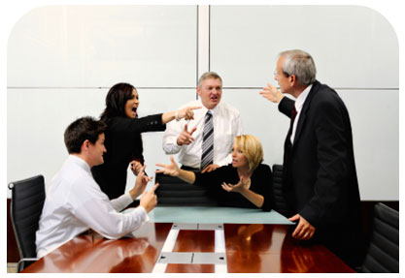

UCC 102: COMMUNICATION SKILLS

Slide 3
INTRODUCTION
Communication is a key element in any human activity. Communication is a learned skill.
most people are born with the physical ability to talk, however, not all can communicate well unless they make special efforts to develop and refine this communication skill.
Very often, we take the ease with which we communicate with each other for granted, so much so that we sometimes forget how complex the communication process actually is.
Communication takes place when we are supposedly at the same level of understanding and comprehension as other interlocutors.
Common forms of communication include speaking, writing, gestures, touch, using pictures and broadcasting. Communication is therefore not what is said whether verbally or non-verbally, but what is understood.

Slide 4
Quotes about communication
You are not only responsible for what you say, but also for what you do not say."– Martin Luther
Think like a wise man but communicate in the language of the people. William Butler Yeats
We have two and one mouth so that we can listen twice as much as we speak. Epictetus
Communication is the real work of leadership. Nitin Nohria
The way we communicate with others and with ourselves ultimately determines the quality of our lives. Anthony Robbins
“Talk is free but the wise man chooses when to spend his words.” Neil Gaiman
When we change the way we communicate, we change society” Clay Shirky
“Constantly talking isn't necessarily communicating.” Charlie Kaufman

Slide 5
In this LECTURE!
By the end of this lecture, you should be able to:
  Define the term ‘Communication’
  State the purpose of Communication
  Explain the advantages of studying communication comprehensively
  Describe the nature and characteristics of communication
  Analyse the elements in the communication process.

Slide 6
why study communication
Some misperceptions

Slide 7

“As an engineer, my job is just to develop the best technical solution. So why do I need communications skills? “
“This is a common view from engineers. What are your thoughts?

Slide 8
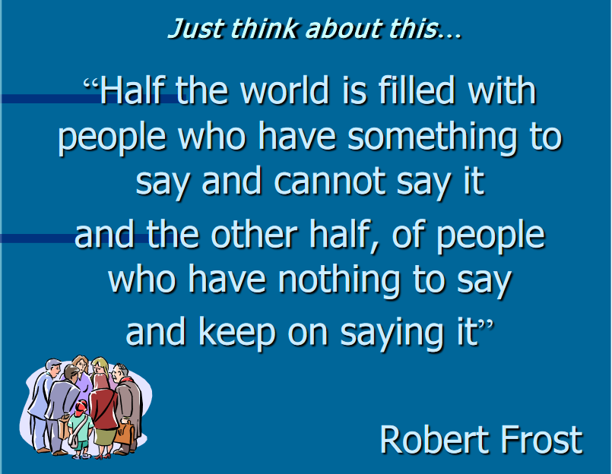

Slide 9
refers to the resourceful intellectuals, the elites, who have lots of ideas—ideas that can actually rule the world if only they are shared properly. Unfortunately, even resourceful people fail to deliver their contents because they are not able to communicate properly.

Slide 10
Why Study Communication?
Your Quality of Life Depends Primarily on Your Communication Skills
1. Studying communication can improve the way you see yourself. Communication is “vital to the development of the whole person”
2. Studying communication can improve the way others see you.
3. Studying communication can increase what you know about human relationships. The field of communication includes learning about how people relate to each other and about what type of communication is appropriate for a given situation.
.Studying communication can teach you important life skills. such as critical thinking, problem solving, decision making, conflict resolution, team building, and public speaking.
5. Studying communication can help you exercise your constitutionally guaranteed freedom of speech.

Slide 11
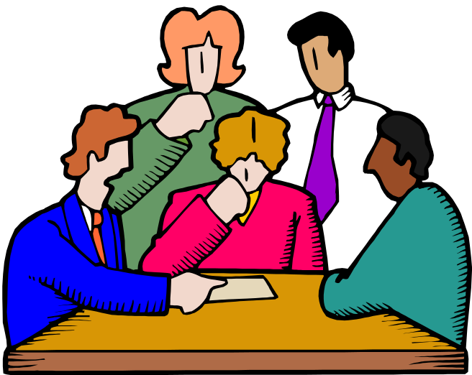
What is communication?
What do you think communication is? How would you define it
Take a few minutes to write down some of your thoughts…

Slide 12
The word communication originates from the Latin communicare and the French communis, both of which mean, ‘common.’
From this information about the origin of the word, we can note the importance given to the aspect of ‘commonality’ in communication.
In simple words we can say that communication is the process of transmitting & Receiving Messages.

Slide 13
Important to note
Communication is innate- we are all born with the ability to communicate e.g since you were a baby you have been communication. A baby's cry can mean so many things: hunger, discomfort etc.
Communication is intuitive-people can communicate without studying communication. However, if you want to be a good communicator, it is important for you to understand the theory of communication.
Communication is continuous-there is no definite beginning nor end. We send and receive messages simultaneously.

Slide 14
Purpose of communication
Communication in the business world is always purposeful. Understanding communication purposes helps the communicator to tailor their messages in order to achieve their intended purpose.
To inform
To persuade
To create good will

Slide 15
Why do we communicate?
We communicate to:
  Share our ideas and opinions
  Provide feedback to others
  Get information from others
  Gain power and influence
  Develop social relationships
  Maintain self-expression and our culture
  and other ideas you may have thought of

Slide 16
Characteristics of Communication
Communication is a process. No message occurs in isolation; it is a process
Unavoidable
two way –communication can take place only when there are at least two people
dynamic. It is not static. It is continuous-goes beyond what we say eg gestures, tone of voice
symbolic.
contextual. Context affects communication
irreversible. Once words are out of the mouth or information written, sent and received, communication cannot be reversed
purposeful. Communication is purposive because it is done to achieve a goal for both the initiator and the receiver

Slide 17
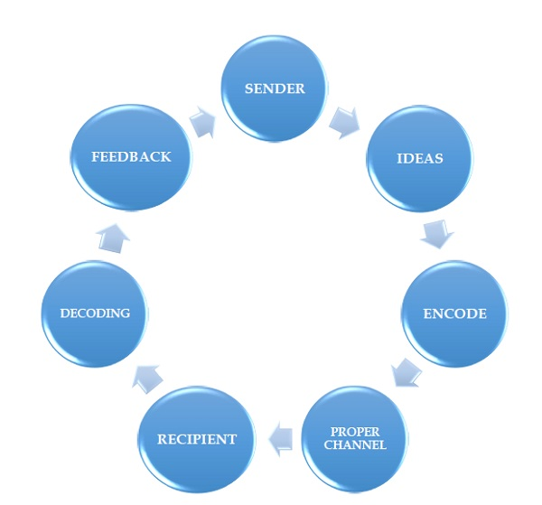
How does communication work?
Elements of the communication process

Slide 18
Sender (Encoder)
When you sending the message, you are the “Encoder” .
, The sender is the person who has a message to be communicated.
the source could be any individual or collection of individuals—one person, a group, or an entire organization. It could be a group of managers wanting to explain policy changes to employees, or it could be one employee explaining to another employee how to complete a certain task.

Slide 19
Encoding
the process of formulating ideas, thoughts and feelings about objects and events such as words, symbols, charts or gestures and transforming them into some form of message. The way the sender perceives, organizes and interprets the objects can affect the encoding process. The sender’s skills, attitude, knowledge and socio-cultural system also affects the encoding process.

Slide 20
The message
The outcome of the encoding process- can either be verbal or non-verbal. A verbal message is communicated by use of a language. Non-verbal communication touches the form of facial expressions, body posture, tone of voice, eye contact, touching, gestures and spatial distance.

Slide 21
The medium
This is the carrier of the message from the sender to the receiver. The most common medium is face-to-face conversations, telephone conversations, group conferences, written reports, charts and internal memos. The objective of the communication determines the type of medium to be used.

Slide 22
The receiver
the person who acquires the source's message. Like the source, the receiver can be an individual, a group, or an entire organization.

Slide 23
Decoding
Decoding refers to the process by which the receiver interprets the message and translates it into meaningful information. When the receiver receives the message, he/she translates the message ideas, thoughts and feelings. The messages received are then interpreted into things or events that can convey some meaning to the receiver. Decoding is affected by the personal values and beliefs, perception and knowledge of the receiver.

Slide 24
Feedback
Feedback is the receiver's observable response(s) to a source's message. Such responses can be either of a verbal nature (for example, I don't agree with you; Yes, that is right!) or a nonverbal nature (for example, a frown, shaking one's head in disagreement, nodding in agreement). Feedback enables the sender to know whether or not the message has been received and interpreted correctly.

Slide 25
whAt have we learnt?
communication is a two-way process that results in shared meaning or common understanding
feedback is the receiver's response to the sender's message and can take different forms.
Communication takes place in different contexts: intrapersonal, interpersonal, small group, public, organizational or mass
A model can be used as a theoretical representation of the communication process.
communication can be affected by noise/ barriers- anything that interferes with the achievement of understanding between the sender and the receiver.
A good communicator will anticipate and try to avoid the barriers in the communication process

Slide 26
Noise
Noise is any factor that disturbs or interferes with the process of communication and hence in the understanding of the intended meaning of the message. Noise may be internal (e.g., an inattentive receiver) or external (e.g., conducting a conversation in noise of machines in an assembly line). The senders’ attitude, assumptions and perceptions can affect the encoding process adversely. The receivers’ attitudes towards the message and the sender can also distort the decoding process. Environmental sounds can also interfere with the transmission of a message.

